Slide 1

Street Lights

Slide 2

Introduction
The dataset we are working with contains comprehensive information about street lights, including shape coordinates, physical attributes (such as head style, bracket length, and pole height), operational characteristics (such as wattage and light source), and additional contextual data. Through rigorous analysis of these attributes, we seek to construct classification models that accurately predict the type of street light fixture based on its features. Additionally, we aim to employ outlier detection techniques to identify anomalies or irregularities in the dataset that may warrant further investigation.

Slide 3
Objective
In this project, our objective is to answer,
"What are the key contributing factors influencing the classification of street lights into different types based on various attributes, and how can outlier detection techniques help identify anomalies within the dataset?”

Slide 4
Business Understanding:
Determine Objectives: Maknig performed decisions for example which light is most being used through outlier and classification.
Assessing the Situation:As per the situation, the data is not fully complete, there are missing instances from the attributes, so the selection and exclusion shall also happen according to this in the steps of Data Preparation. We have access to efficiently use the machine learning algorithms such as decision tree, KNN and outlier detection methods like LOF and ISF through software known as RapidMiner.
Data Mining Goals: Utilize machine learning algorithms such as decision trees and KNN for classification, LOF and ISF for outlier detection
Produce Project Plan: Evaluation will be happened based on both the KNN and Decision tree classification methods and check the anomalies presented by the outlier detections which are affecting the outcomes or needed to know to make confirmed decisions about finding the type of lights, which is what our overall aim is and that is what this project is all about.

Slide 5
Data Understanding
Initial data is collected form the open Ottawa platform where we
download and analyze the data according to our project needs. And data
for this is about Street Lights with more than 70000 instances.
1. Collect Initial Data
2. Describe Data
In total there are 74,031 instances of the dataset but
for this report 10000 instances are selected for performing
all the operations mentioned before. The information about attributes
is as below with their datatypes:

Slide 6

Attributes

Slide 7
Attributes

Slide 8
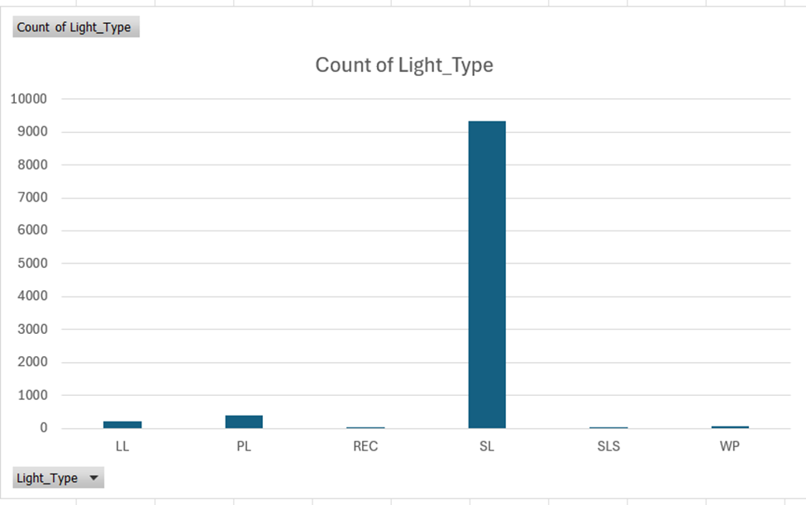
Data Understandng
Explore Data:
This chart is the class labeled chart of Light type attribute which shows the distribution of each type of light among the instances provided.

Slide 9
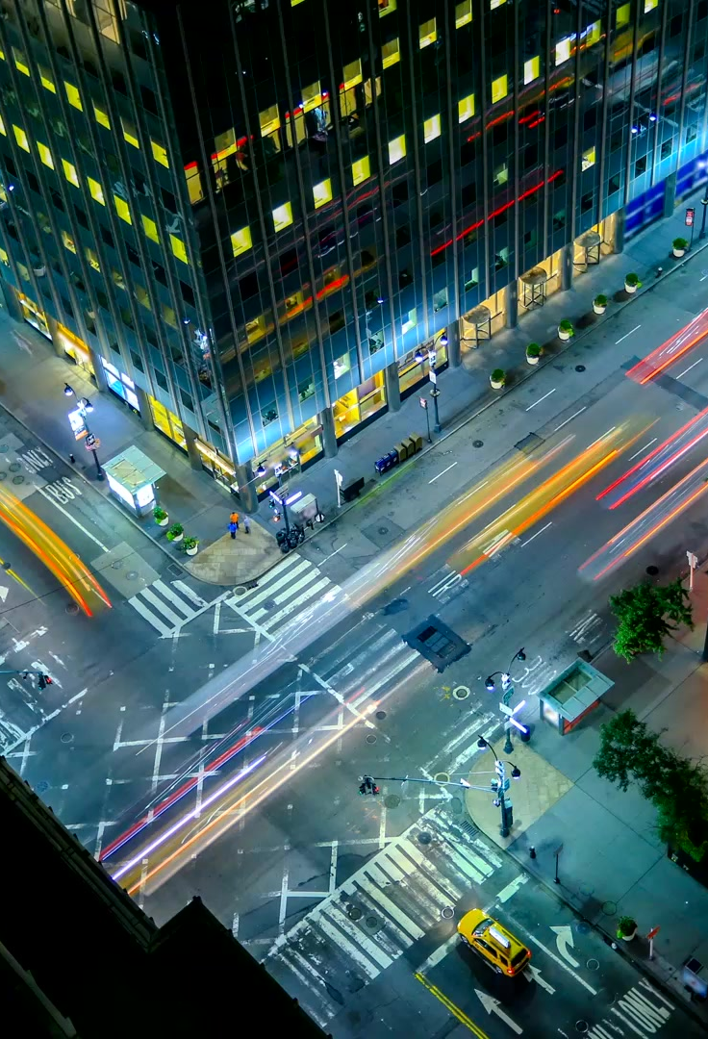
Exploration
I explored of Street Names attribute that it is imperative attribute for consideration as part for modelling because it shows the regions where the most amount of light are installed and what are the types of those lights as we can see if all those lights are of LED type or not as the aim for Ottawa lights is to converts them to LED type. And these insights are important while classifying as these independent variables are what going to show their presence on dependent variable by their coefficient to classify each type.
Additional updates are also pending which contributors are solving on quarterly basis, and one point to be noted is that not all the Ottawa street lighting is shifted on LED (Light Emitting Diode) type lighting because it is energy efficient but uses HSP (High Pressure Sodium) mostly which is high on energy consumption and having
lesser lifespan and more management costs as compared to Light Emitting Diode.
So, these are what we have explored through this exploration about the possible relationships between the attributes.

Slide 10
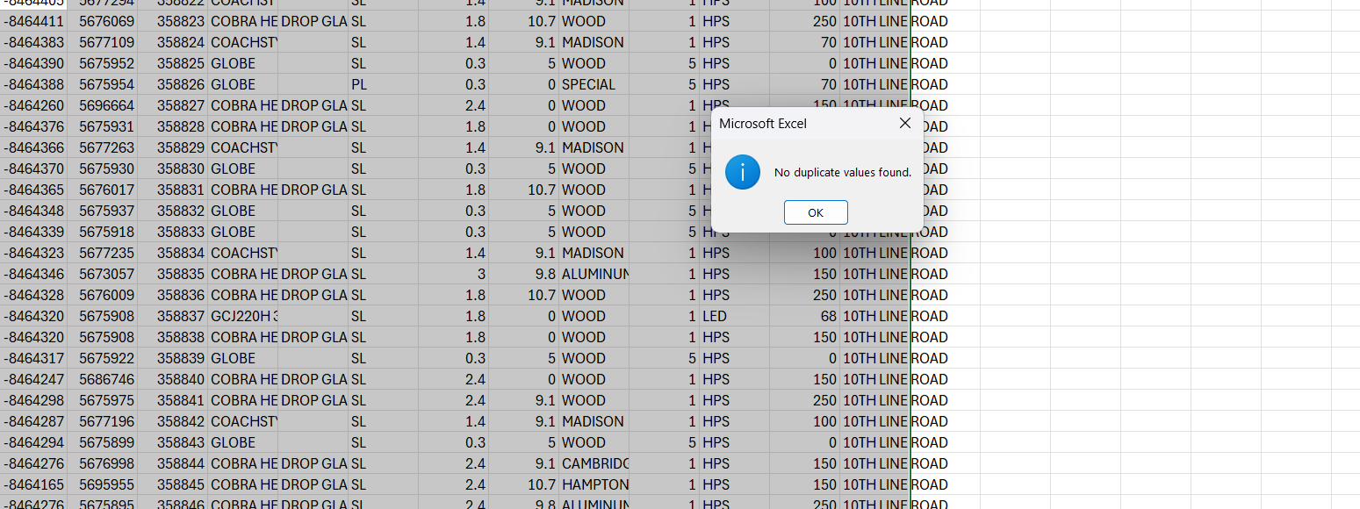
Verify
Verify Data:
Data is not complete as previously mentioned there are attributes with missing values such as light type and refractor attribute, there is some noise present
in attribute head style where some of the values are not common ones, which needs to focus on but needed for selection purposes.
Data has no duplicate values but yes data is not complete, and I am only considering the specific parts of data which I mentioned in the phase of selecting the data.

Slide 11
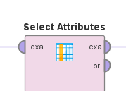
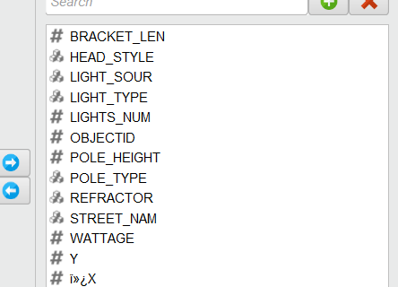
Data Preparation
Select Data:

Slide 12
Clean Data

Slide 13
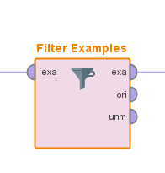
Construct
Derivation of attributes upon conversion of attributes, when the required attributes get converted to numerical or normalized for classification purposes the attributes with polynomial datatype other than class label will converted to binary types representing different columns in the outcome.
The attributes named pole type, head style and light source are converted into numeric data types for classification purposes whereas other attributes stay same as well as class label attribute which in this case is Light type.
Data Sampling: As the dataset is large, considered applying data sampling techniques to reduce the size.

Slide 14
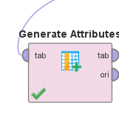
COnstruct
BANK STREET - Downtown, BRONSON AVENUE - Centretown, KENT STREET - Centretown, 10TH LINE ROAD - Orleans, SPARKS - Downtown, SUSSEX DRIVE - Lower Town, QUEEN STREET - Centretown, BASELINE ROAD - Nepean, HUNT CLUB ROAD - Hunt Club, CARLING AVENUE - Carlingwood, PRINCE OF WALES DRIVE - Meadowlands, MARIVALE ROAD - Nepean, WOODROFFE AVENUE - Nepean, RIDEAU STREET - Downtown, RICHMOND ROAD - Westboro, INNES ROAD - Orleans, WELLINGTON STREET - Downtown, RIVERDALE AVENUE - Westboro, WALKLEY ROAD - South Keys, MONTREAL ROAD - Vanier, RIVERSIDE DRIVE - Riverside South, INDUSTRIAL AVENUE - Trainyards, COLONEL BY DRIVE - Sandy Hill, ALTA VISTA DRIVE - Alta Vista, ST. JOSEPH BOULEVARD - Orleans, PINECREST DRIVE - Pinecrest, GREENBANK ROAD - Barrhaven, ROBERTSON ROAD - Bells Corners, GREENFIELD AVENUE - Centrepointe, ELGIN STREET - Downtown, PRESTON STREET - Little Italy, BEECHWOOD AVENUE - New Edinburgh, SOMERSET STREET WEST - Chinatown, BAYSHORE DRIVE - Bayshore, CARLETON AVENUE - Carleton Heights, OLD RICHMOND ROAD - Richmond, OGILVIE ROAD - Beacon Hill.
And used the Generate Attribiutes operator for genrating new attribute names REGION by the use of expression shown in picture below.

Slide 15
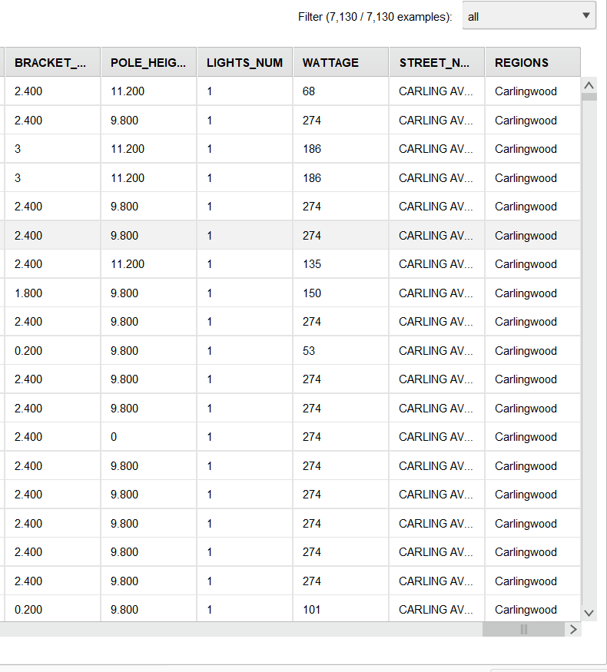
Construct

Slide 16

Data Preparation
Integrate Data:
Data integration techniques are applied to merge data obtained after outlier detection using both the LOF and ISF where we joined the original columns of data and outlier columns from both the methods and outlier flag column.
Format Data:
Data formatting ensures consistency in attribute types and values, preparing the dataset for modeling. In here we removed required attributes to format data in expected form.
For example, we removed the created date and modified date, pole and light installation date, energy jurisdiction, pole id, and 1 year dimming as these are not relevant and considered as redundant, for the classification purposes.
Data Type Adjustment: Changed the data types for the head style, refractor, pole type, light source, Region attributes for applying the distance-based methods such as KNN and Decision

Slide 17
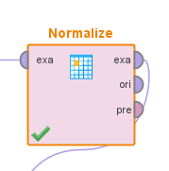
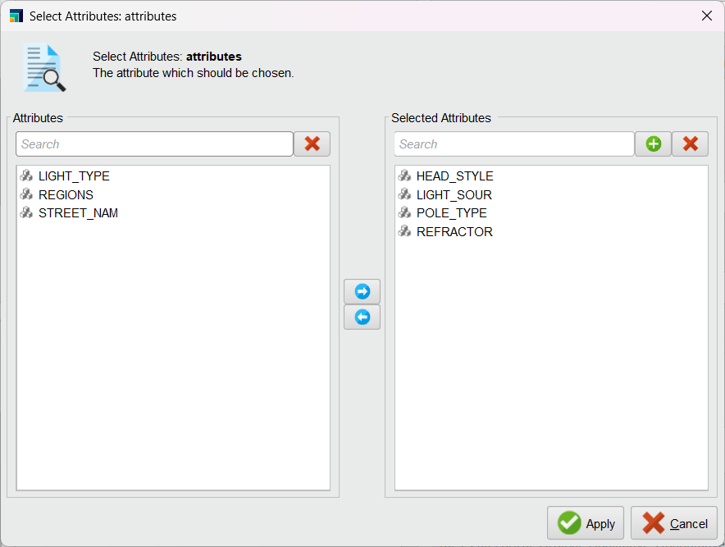
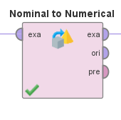
Format

Slide 18
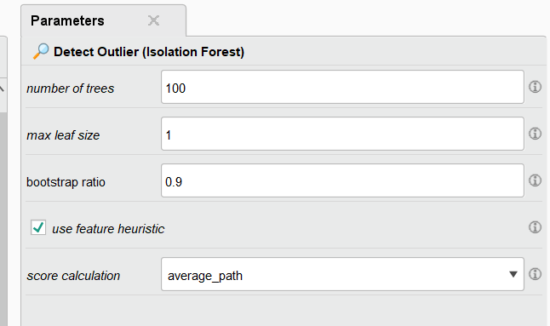
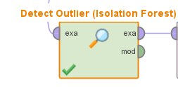
MOdelling
In modelling I am using the ISF and LOF for outlier detection and for classification, KNN and Decision Tree and
Random Forest.
Outlier Detection:
ISF: Isolation Forest outlier detection means isolating anomalies in the dataset by randomly selecting a feature and
then randomly selecting a split value between the maximum and minimum values of the selected feature.
For example, here I am using the ISF operator in RapidMiner with parameters mentioned below in picture,
and this is selecting random attribute, and you can see the minimum and maximum values of that feature.

Slide 19
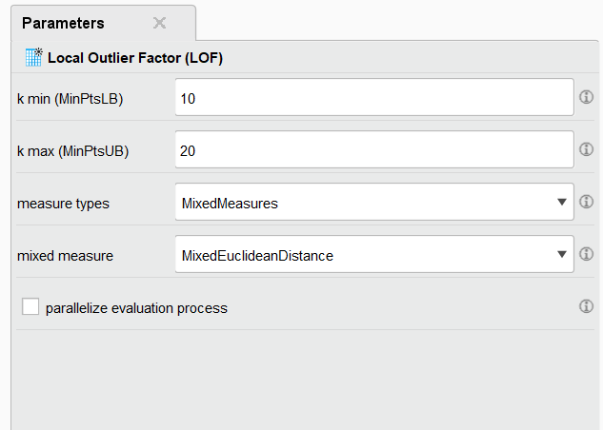
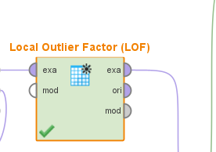
Modelling
LOF: Local Outlier Factor is another method for outlier detection it works by identifying the outliers based on deviation from the local density of their neighbors.
It measures the local density of a data point with respect to its neighbors and compares it to the densities of its neighbors. Points with significantly lower densities
compared to their neighbors are considered outliers. LOF can capture outliers that are within dense regions of the data, making it effective for detecting outliers in
clusters or groups. For example, in my project I used the LOF operator for this type of detection, with these parameters.

Slide 20
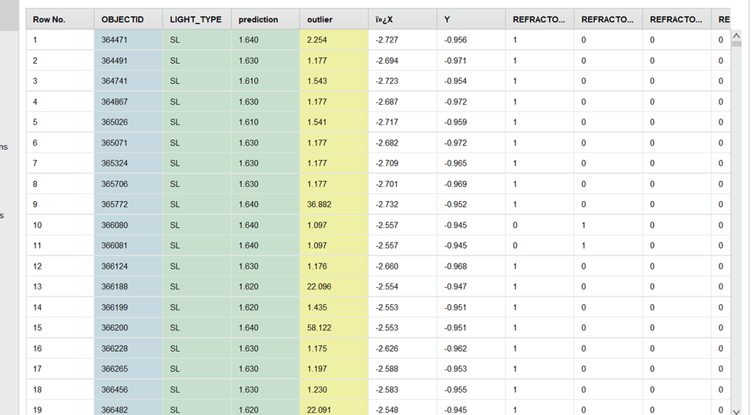

Slide 21
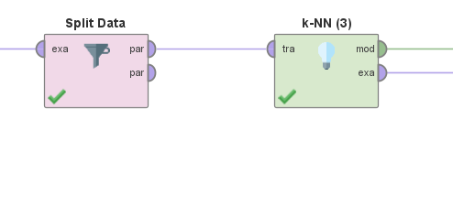
KNN
KNN: K- Nearest Neighbors simple and intuitive algorithm used for both classification and regression tasks, the prediction for a new data point is determined by the majority class (for classification) or the average value (for regression) of its k nearest neighbors in the feature space, KNN's performance can be sensitive to the choice of the distance metric and the value of k.
For example, In my project for Street Lights I am using the Light Type attribute as a class attribute and used the KNN and split data using
Split Data operator for dividing data into 70/30 percentage

Slide 22
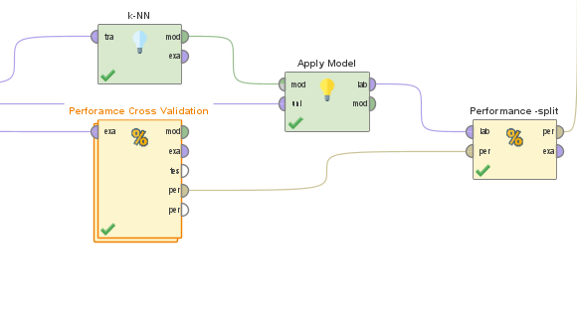
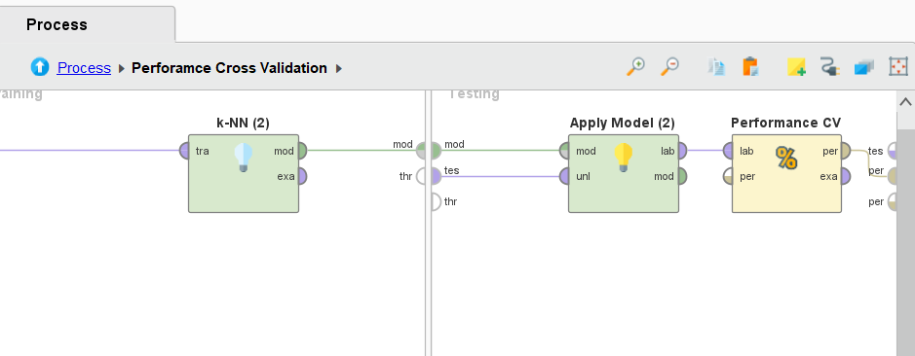
Operators

Slide 23
KNN

Slide 24
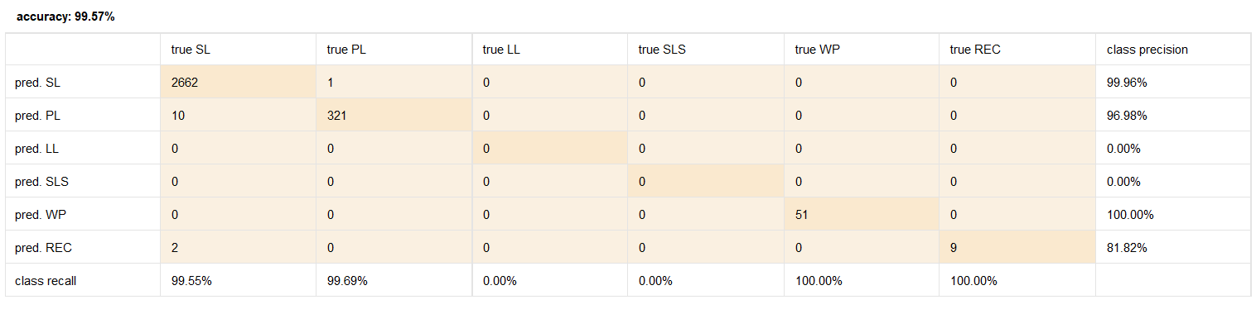
Confusion matrix

Slide 25
Decision Tree

Slide 26
Results

Slide 27
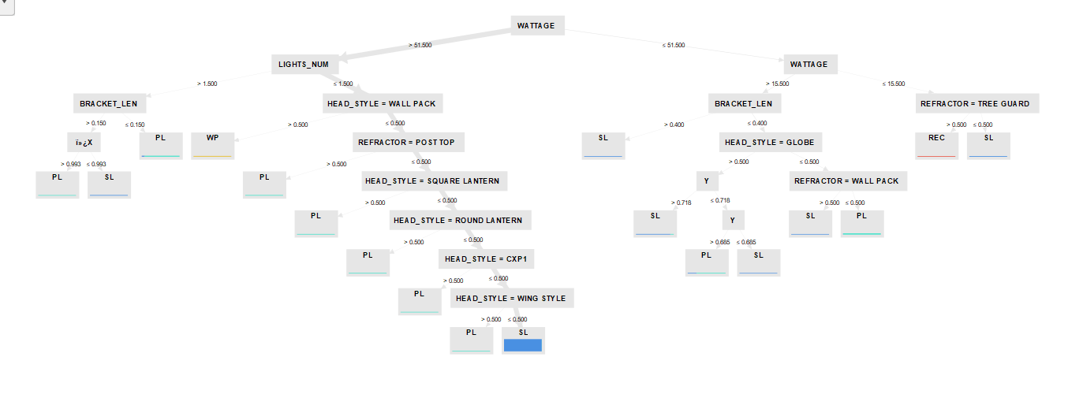
tree

Slide 28
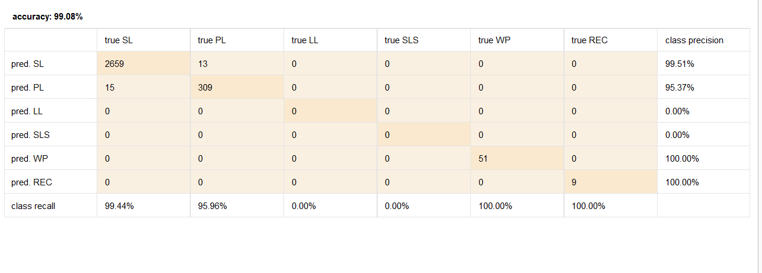
Confusion matrix

Slide 29
Classification
Random Forest:
Random Forest is an ensemble learning technique used in machine learning for both classification and regression tasks. It operates by constructing a multitude of decision trees during the training phase and outputs the mode (for classification) or the mean prediction (for regression) of the individual trees.
Accuracy: 90.74%, Classification Error: 9.26% and Root Mean Squared Error: 0.244
Parameters as Number of Trees-5, Maximal depth-10 and unpruned.

Slide 30
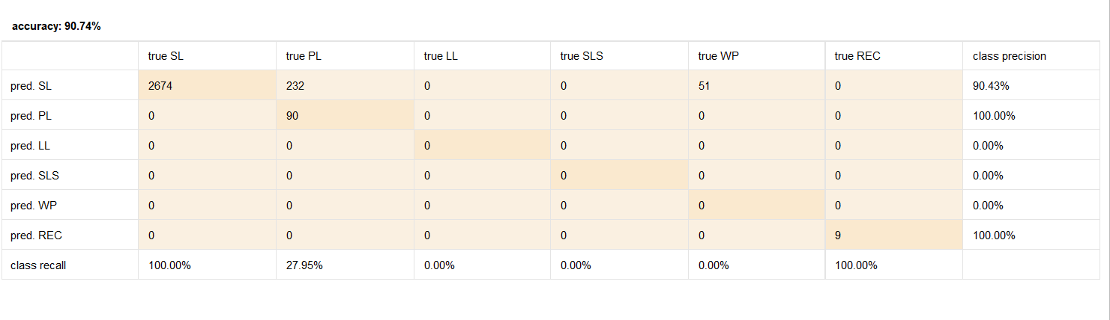
Confusion matrix

Slide 31
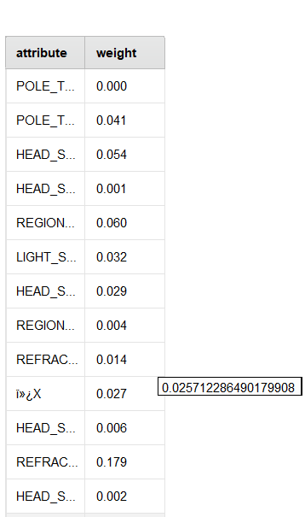
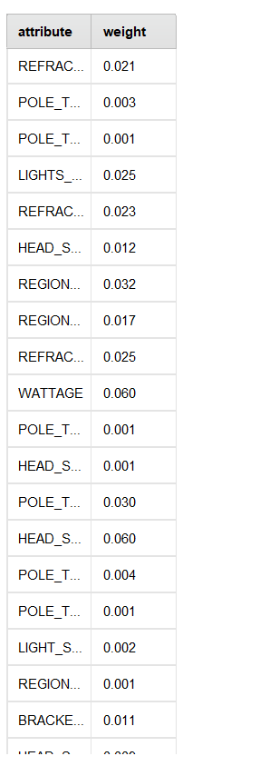
Wieghtage

Slide 32
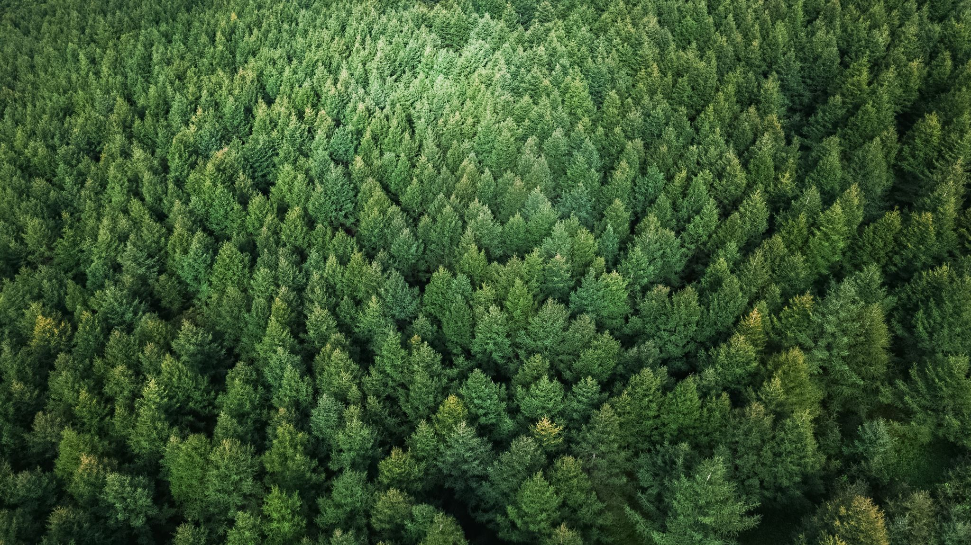
COnclusion
KNN performed very well on testing data in all the given parameters with highest accuracy of 99.66% with value of K as 20. Whereas Decision Tree performed low as compared to KNN but still better than Random Forest with the highest accuracy of 99.08% with the given parameters of 10 depth and unpruned.
At the End Random Forest performed less efficient than KNN and Decision Tree with the highest accuracy of 90.74% on uprunning and maximum number of trees as 5.
So, the KNN is the Best amongst the all the modelling techniques applied over the course of this project and showed great efficiency not only on trained set but most efficiently on Untrained set as well.
And refractor, head style, region are the most contributing attributes in prediction.

Slide 33
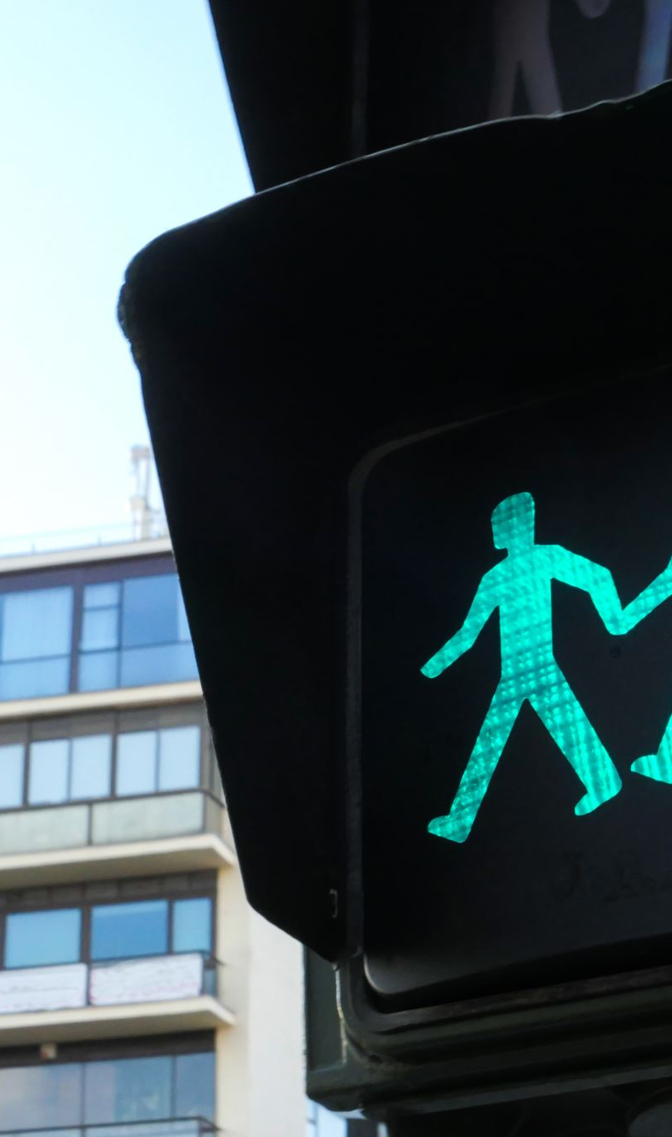
References
[1] “Street Lights,” open.ottawa.ca. https://open.ottawa.ca/datasets/street-lights (accessed Mar. 29, 2024).

Slide 34

The End Gurminder singh Badwal

